Slide 1


The SSP Challenge:
How to Build a Plan that Will Pass an Assessment
March 30, 2022

Slide 2
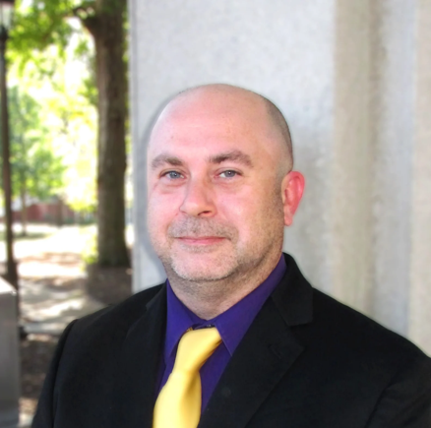


Speakers
Dr. Thomas Graham
Redspin
Robert Teague
Redspin
Noël Vestal
PreVeil

Slide 3
Agenda
  Who’s my audience for the SSP
  What needs to be in my SSP
  How to organize your SSP?
  Key take aways
  Q &A

Slide 4
Who’s my audience?

Slide 5
SSP Definition
    The System Security Plan (SSP) is the formal document that provides a high-level overview of the security requirements for an information system and describes the security controls in place, or plan to be in place, for meeting those requirements

Slide 6
What needs to be in my SSP?

Slide 7
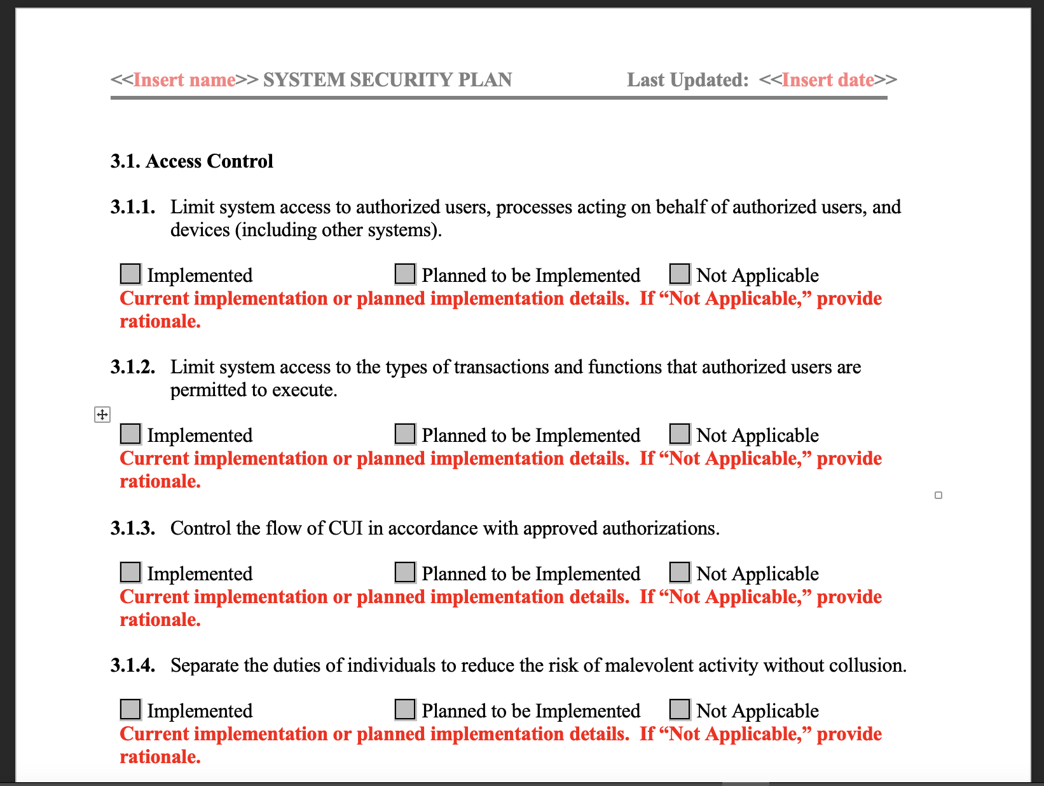
NIST SSP Template
The National Institute of Standards and Technology (NIST) provides an SSP template that an organization can use
https://csrc.nist.gov/csrc/media/Publications/sp/800-171/rev-2/final/documents/CUI-SSP-Template-final.docx

Slide 8
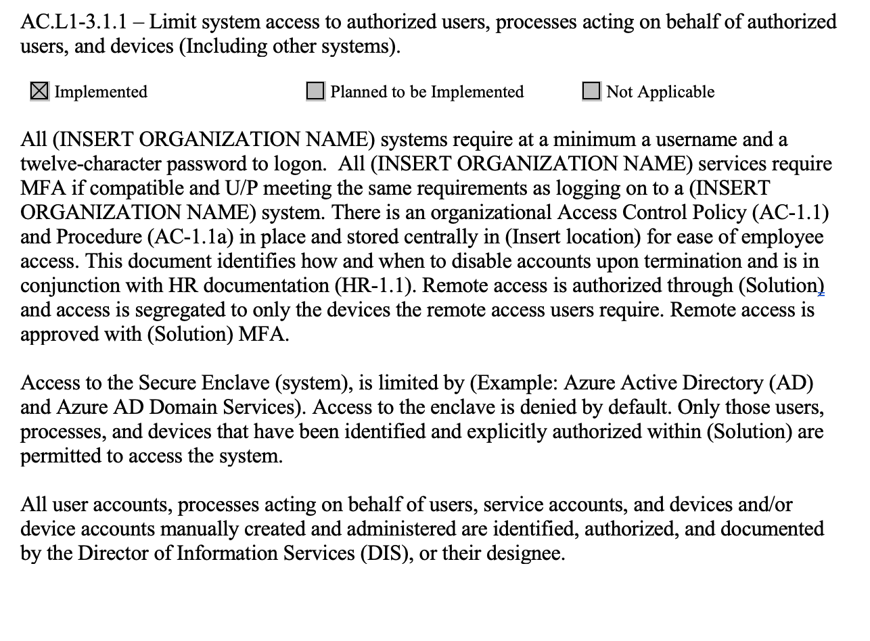
Access Control
3.1.1 – Limit system access to authorized users, processes acting on behalf of authorized users, and devices (including other systems)
…

Slide 9
Access Control - Example
Goal: Limit Information System Access
Name | CUI Access | Endpoint Info | OS | OS Version | PreVeil access
Alice | Y | ThinkPad | Windows 11 | 21H2 | Y
Bob | Y | ThinkPad | Windows 11 | 21H2 | Y
Chris | N | Mac | Mac 12 | 12.2.1 | N
Doug | Y | Mac | Mac 12 | 12.2.1 | Y
Eve | N | Mac | Mac 12 | 12.2.1 | N

Slide 10
Access Control - Example
Goal: Deny by Default
Rule | Action | Protocol | Source | Destination | Port
1 | Deny All | TCP | Any | Any | 135
2 | Deny All | TCP | Any | Any | 137-139
3 | Deny All | UDP | Any | Any | 137-139
4 | Deny All | IP | Any | Any | 53
5 | Deny All | IP | Any | Any | 443

Slide 11
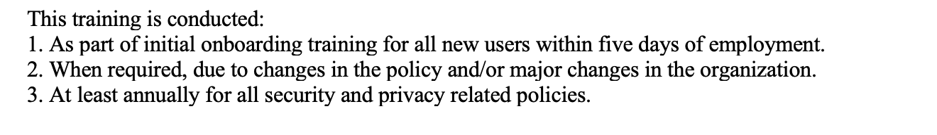
Awareness & Training
3.2.1 – Ensure that managers, systems administrators, and users of organizational systems are made aware of the security risks associated with their activities and of the applicable policies, standards, and procedures related to the security of those systems.
…

Slide 12
Awareness & Training - Example
Name | Training | Date attended | Frequency | Administrator
Alice | Security Awareness | 4/1/2022 | On-hire/Annual | Frank
Bob | Security Awareness | 4/1/2022 | On-hire/Annual | Frank
Chris | Role Based Training - Admin | 3/28/2022 | On-hire/Semi-Annual | Gene
Doug | Role Based Training – Power User | 3/27/2022 | On-hire/Semi-Annual | Gene
Eve | CUI Training | 3/15/2022 | On-hire/Annual | Heather

Slide 13
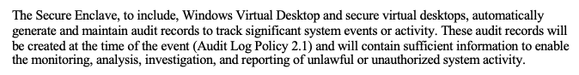
Audit & Accountability
3.3.1 – Create and retain system audit logs and records to the extent needed to enable the monitoring, analysis, investigation, and reporting of unlawful or unauthorized system activity
…

Slide 14
Audit & Accountability - Example
Auditable Events
Windows Event ID | Potential Criticality | Event Summary | Rationale
4618 | High | A monitored security event pattern has occurred. | Investigate immediately
4649 | High | A replay attack was detected. May be a harmless false positive due to misconfiguration error. | Investigate immediately
4892 | Medium | A property of Certificate Services changed. | Monitor for unexpected occurrences
4720 | Low | A user account was created. | Monitor for increased occurrences

Slide 15
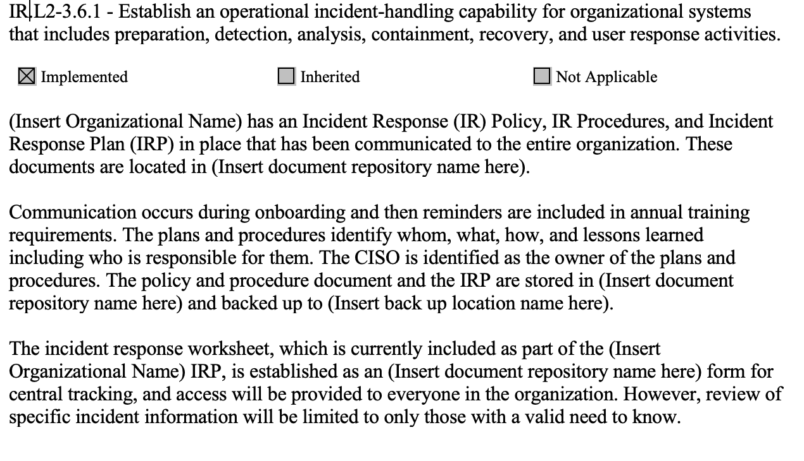
Incident Response
3.6.1 – Establish an operational incident-handling capability for organizational systems that includes preparation, detection, analysis, containment, recovery, and user response activities.
…

Slide 16
Incident Response Example
Incident | Point of Contact | Stakeholders Alerted | Location of Incident Documentation and Tracking | Incident Resolution
Physical Security Breach | Alice | Executive Staff, Facility Security Officer, Office Manager | Location of IR Documentation/Tracking | Location of IR Resolution Info
Whaling | Bob | IT Manager | Location of IR Documentation/Tracking | Location of IR Resolution Info
Social Engineering | Chris | Executive Staff, IT, Manager, Human Resources | Location of IR Documentation/Tracking | Location of IR Resolution Info
CUI Data Spillage | Diane | Executive Staff, Facility Security Officer, IT Manager | Location of IR Documentation/Tracking | Location of IR Resolution Info
Network Penetration | Edward | Executive Staff, IT Manager | Location of IR Documentation/Tracking | Location of IR Resolution Info

Slide 17
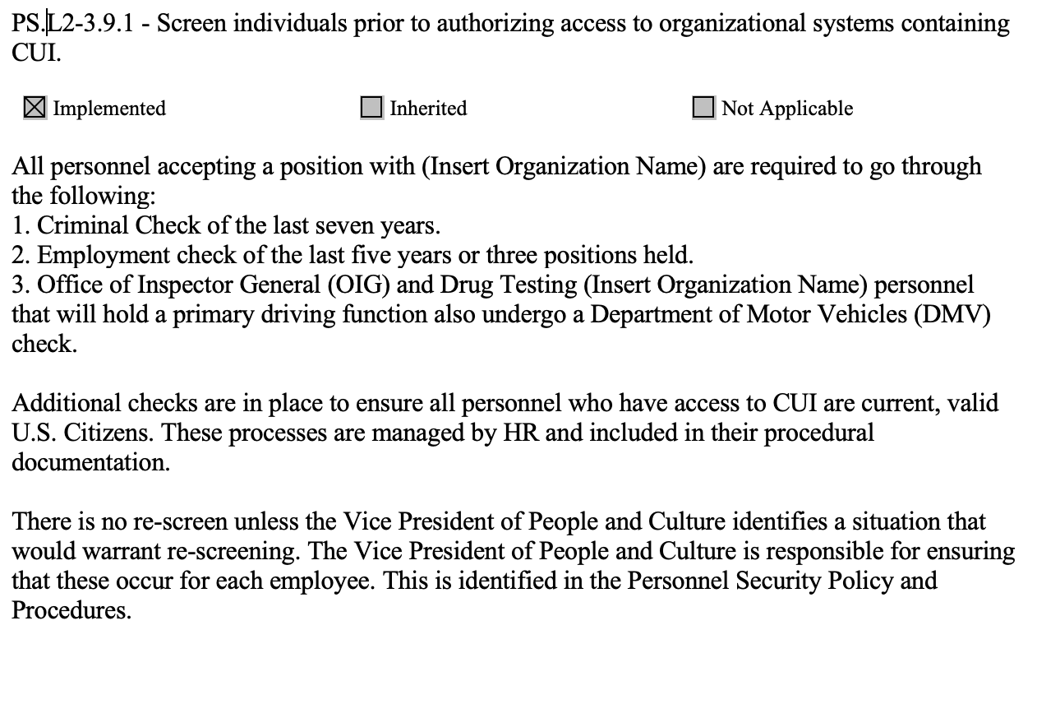
Personnel Security
3.9.1 – Screen individuals prior to authorizing access to organizational systems
containing CUI.
…

Slide 18
Personnel Security Example
Employee | Background Check Performed | Date Performed | How Background Check was Performed | Results of Background Check
Alice | Secret | 4/1/2022 | DoD Background Check | Cleared
Bob | TS-SCI | 3/28/2021 | DoD Background Check | Cleared
Chris | General Background Check | 8/8/2020 | ACME Background Checks | No Issues Found
Diane | Financial Background Check | 6/5/2019 | ACME Financial Background Checks | No Issues Found
Edward | Public Trust | 7/8/2021 | DoD Background Check | Cleared

Slide 19
How to Organize Your SSP

Slide 20
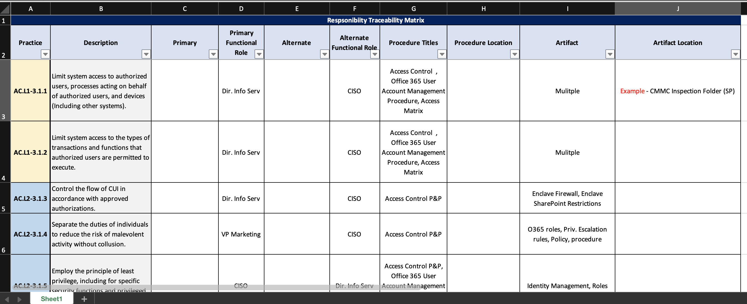
Responsibility Matrix is the best way to track organizational documentation via CMMC practice, descriptions, roles, artifacts, and artifact locations. Note: The roles listed below are examples.

Slide 21
Key Take Aways

Slide 22
Follow NIST SP 800-171r2 and 800-171a.
Examine artifacts are a ”choose from” option for the assessor. Typically, if you provide two or three artifacts to examine, per practice, the assessor will be satisfied.
Documentation states what you are doing (Examine), Interviews check that staff know what they are supposed to do (Interview), Testing allows the assessor to see that you are doing what you said you would do (Test).
Don’t overthink it (Keep it simple).
Remember who the audience is (Mainly employees, but also assessors & auditors).
Keep items short, concise, and to the point.
If possible, reference out to policies & procedures.
It’s okay to utilize templates (Just make them your own).
If all else fails, seek assistance from an approved RPO or C3PAO (Don’t be afraid to ask for help).

Slide 23


Q&A
Thomas Graham
Robert Teague
Noel Vestal
Redspin.com
Redspin.com
preveil.com
thomas.graham@redspin.com
robert.teague@redspin.com
compliance@preveil.com

