Slide 1



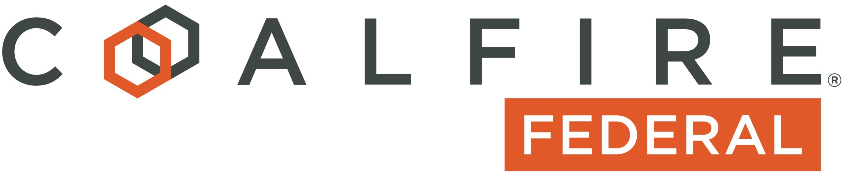
Securing the Defense Supply Chain
February 23, 2021

Slide 2




Panelists
JC Dodson
CSO
BAE Systems
Robert Metzger
Cyber Attorney RJO
Stuart Itkin
VP
Coalfire Federal
Randy Battat
CEO
PreVeil

Slide 3

About Coalfire Federal
Coalfire Federal provides cybersecurity services to government and commercial organizations helping them protect their mission-specific cyber objectives.
Coalfire Federal is the leading FedRAMP 3PAO, a CMMC C3PAO and CMMC RPO and offers a full spectrum of cybersecurity risk management and compliance services
About Stuart Itkin
Coalfire Federal VP CMMC and FedRAMP Assurance
Previously VP Product Management and Marketing at Exostar, Global CMO at CEB
Executive roles in several cybersecurity businesses
Lead mentor at MACH 37 cyber product accelerator
-3-

Slide 4
About JC Dodson
Jeffrey C. (“J.C.”) Dodson is the Global Chief Security Officer for BAE Systems Inc.
He is responsible for corporate security strategy, operations and assurance. His risk management portfolio includes all elements of industrial, international and cyber security for U.S. and overseas business operations. He is principal advisor to the Board of Directors’ Government Security Committee and has operational oversight of the corporation’s Special Security Agreement (SSA) with the U.S. Department of Defense.
Prior to his CSO appointment in 2020, Dodson served as BAE’s Global Chief Information Security Officer (CISO) since 2010. During his tenure with the company, he has held a variety of executive positions in program management, strategy, business development and security. He joined BAE Systems in 2002 following a 22-year career with the U.S. Air Force that included flying operations, weapons system acquisition management, and command assignments.
Dodson currently serves on the Board of Directors for the National Defense-Information Sharing and Analysis Center (ND-ISAC). He is a member of the Department of Homeland Security’s Defense Industrial Base Sector Coordinating Council and is an industry contributor/advisor to numerous U.S. Government national security policy studies and initiatives.
-4-

Slide 5

About PreVeil
PreVeil is a simple, inexpensive and secure SaaS platform for storing and sharing CUI and ITAR data in email and files.
Designed for the enterprise, PreVeil is used by leading defense contractors for CMMC compliance, Supply Chain Collaboration and Incident Response.
About Randy Battat
Co-founder and CEO of PreVeil since 2015
Previously, CEO of Airvana
Led teams at Motorola and Apple
BS in Electrical Engineering, Stanford University
-5-

Slide 6
About Robert Metzger
Robert is a leading cyber attorney and supply chain expert. He is co-author of MITRE’s ‘Deliver Uncompromised’ report, which is widely credited with having had significant influence on a broad range of security initiatives of the Department of Defense and civilian agencies.
He also heads the Washington DC office of law firm RJO and is co-chair of the firm’s Cybersecurity and Privacy Practice Group, and is a member of the Government Contracts Practice Group.
In his litigation practice, he was counsel of record for Microsoft Corporation in the Court of Federal Claims litigation brought by Amazon Web Services protesting the $10B DoD award of the “JEDI” cloud services contract to Microsoft.
He has advised U.S. aerospace and defense and international technology companies on export control laws, on CFIUS and FIRRMA, and on sanctions issues. He also represents leading information technology hardware, software and solution providers in state and local procurements
-6-

Slide 7
AGENDA
Robert Metzger
Importance of securing the defense supply chain
Impact of the DFARS rule on Primes and suppliers
Primes and suppliers must start preparing now
JC Dodson
Primes need to prepare for their new compliance challenge
Tech solutions that can help
Practical steps for suppliers to get started with compliance
Importance of secure communications with suppliers
Managing the costs of compliance
Randy Battat
Secure communications between Primes and their supply chain
Helping suppliers become CMMC compliant
Managing the costs of compliance
Q&A

Slide 8
Securing The DIB Supply Chain Elevating Security Across the Supply Chain

Slide 9
Elevating Security Across the Enterprise
“The contemporary threat landscape has not been effectively addressed or deterred in our national security missions, policies, and infrastructures. The response is inadequate within the private sector and across government.”
“Our adversaries have developed and demonstrated capabilities to collect valuable intelligence on defense capabilities, steal intellectual property, initiate offensive action, and respond to provocation in an asymmetric manner. They target military as well as private sector U.S. interests ….”
“Actions are presented for the near, medium, and long terms—recognizing the need for immediate action coupled with a long-term commitment and strategy. Cyber and supply chain vulnerability extends well beyond DoD, across government and into the private sector.”
Deliver Uncompromised Report, at 8-9.
Notes:
“Deliver Uncompromised” (DU) has been acted upon by the Department of Defense. But its findings and conclusions and many of its recommendations apply equally to civilian agencies and to commercial organizations generally. Adversaries do not limit their attacks to the DIB, or to federal contractors, or to the A&D sector – far from it. DoD is leading other federal agencies. But the problem it is trying to solve is everyone’s problem – and the measures taken to respond should apply across enterprises. This is difficult, and expensive, and will take time. But the threat is real as are the present risks.

Slide 10
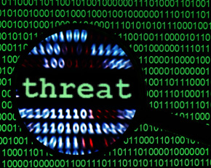
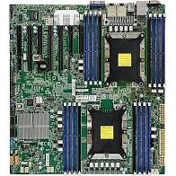
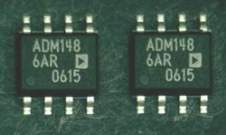
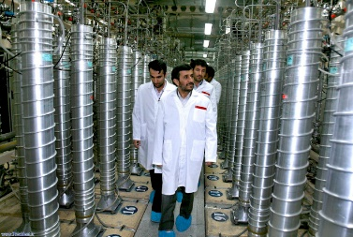

Multiple Attack Vectors
CYBER-IT
SUPPLY CHAIN
“Our supply chains are exposed to multiple threat vectors. Supply chains are one of the four primary elements of an adversarial attack via blended operations. Attacks may be mounted against the entire supply chain life cycle from conception to retirement. The supply chain is vulnerable to adversary insertion of counterfeit parts that pass ordinary inspection but fail operationally. Largely through cyber-physical threats, adversaries may introduce malware or exploit latent vulnerabilities in firmware or software to produce adverse, unintended, and unexpected physical effects on connected or controlled systems. Supply chains as a service present another critical exploitation vector.”
CMMC - NOW
HARDWARE SOFTWARE
INFRASTRUCTURE
LOGISTICS SERVICE PROVIDERS
CYBER/PHYSICAL- OT
Notes:
DoD’s new cyber regulations force our attention to the “cyber IT” attack vector. The actual range of threats is diverse and more complex – including cyber/physical systems and OT, supply chain (Hardware, Software, Firmware, Infrastructure, Logistics Service Providers), and the “human factor.” In the real world, skillful adversaries mount blended operations across several or all of these vectors. Our immediate concern is protection of INFO and INFOSYSTEMs, but organizations should be thinking ahead, especially to supply chain security as the urgency of those risks have been spotlighted by “SolarWinds”

Slide 11
Cyber and Supply Chain Threats
And: Climate Change | Natural Disaster | Pandemic
Who? (Threat: Actors)
Nation states and state-sponsored
Commercial Rivals
Hackers & Criminal organizations
Disloyal and Disgruntled Employees
Poorly Trained Workers
Why? (Threat: Motive)
Political motives
Surveillance & Espionage
Denial of information & technical advantage
Extraction of commercial technology
Impair/disrupt/subvert operations
Inflict financial injury
Extortion, intimidation
Damage mission confidence, effectiveness
Interests threatened? (Risk: Impact)
Confidentiality via unauthorized exfiltration of technical information and other protected data +
Integrity should an attack corrupt data or system integrity +
Availability of information or information systems may be denied or disrupted &
Functionality of devices & industrial control systems (infrastructure, manufacturing, logistics) +
Safety: the IoT connects systems originally designed to act autonomously
Enterprise Value
FISMA
Privacy
Notes:
This chart is intended to remind everyone of just how many threat actors are present and just how many motivations may explain their attempts. Few companies, regardless of business sector, or type of product or service, are immune from threat risk – or consequence. Risk is sometimes expressed as a function of Threat, Vulnerabilities and Impact. Present DoD regulations, including CMMC today, seek to prevent the impact of loss of confidentiality of CUI. That is important for all organizations. But there are other objectives for prudent businesses to consider – all of which combine to affect enterprise value.

Slide 12
At Risk? Everything
Program Cost
Compromised Mission
Industry IP – Enterprise Value
Defense
Critical Infrastructure
Public Functions & Services
ICT
Manufacturing
Social Media
Health Care
5G and IOT Accelerates & Aggravates
Unprotected SCRM
Protected SCRM
Remedy Path Reactive
Remedy Path Proactive
Uncompromised Mission
Acquisition
Deployment
Sustainment
Exploit awareness
Vulnerability Mitigation
Program Time-line
RFP
Adversaries:
Research, Design, Test, C2
Research, Design, Test, C2
Supporting CONOPS
Supporting CONOPS
Exploit
Exploit
”[T]e up-front costs of a representative acquisition appear significantly different for a supply chain adequately protected from inception. The apparent cost differential, however, is significantly smaller for the protected acquisition when compared to the higher total cost of ownership experienced where failure to secure the supply chain initially delivers compromised products requiring expensive attempts at correction later in program life. “ (DU Report, at 21.)
Spend now or pay later? Investment in security as a foundation produces lower total program cost.
Notes:
DoD is pressing some in the A&D industry because it has taken the step of requiring INFOSEC by contract requirement and now by implementing the CMMC mechanism for assessment and certification. As suggested before, however, every industry is at risk, though the objectives of attackers may differ and the consequences (impacts) of attacks may vary as well. If anything, as we become more dependent upon connected instrumentalities (5G, IOT), we become more vulnerable as attack surfaces expand. These lead to a key proposition of DU, that should be considered broadly: investing now in security, at the enterprise, program or project level, can produce a better outcome than producing insecure products or maintaining insecure systems. Repairing the damage done is very expensive – if it can be done at all.

Slide 13
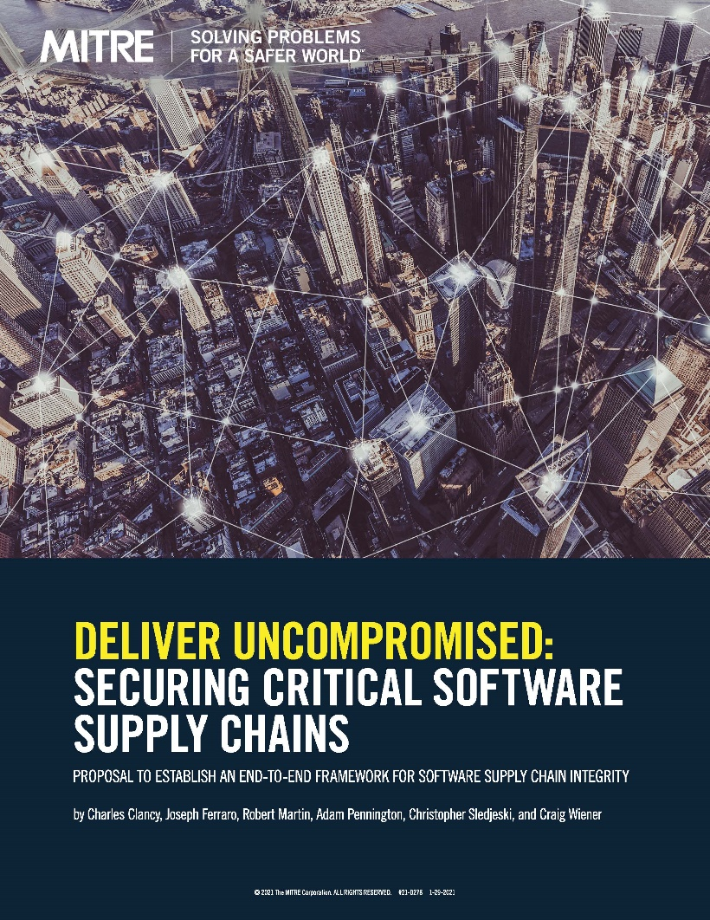
And Now – “SolarWinds”
Summary of the Event
Malware inserted in March 2019 – or before
Attack vectors includes corruption of “Orion” software
Exploitation of trusted software used by thousands
Beyond the initial attack, secondary & tertiary payloads
Not detected by federal/military resources
Known result: surveillance and likely exfiltration
Other backdoors may be present – very hard to find
100 identified “targets, but risk of "“Island Hopping”
Relevance to Information Protection
Consequence to enterprises can be reduced by strong security (e.g., encryption) of key IP, CUI, sensitive business records and communication of same.
2021 MITRE Report
Notes:
One unfortunate truth of the 2018 DU Report is that many of the scenarios we predicted then have been proven true in the 2-1/2 years since. SolarWinds is the most powerful, and troubling. Analysts have worried about supply chain attacks through delivery of corrupted software for some time, and, indeed, SolarWinds was not the first such attack. But the breadth, sophistication, persistence, and complexity of SW surprised many. Worse, its consequences are not yet known fully, and the complete response may take years. We know this – for the targeted companies, exfiltration of sensitive information (IP, proprietary data, CUI) was a key objective as was surveillance of internal or external communications. This points to the importance, for enterprises of all kinds, of protecting what can be done with their sensitive information in the event of system compromise and exfiltration of such data. And that suggests, at least to me, that adverse impacts can be mitigated through strong encryption, E2E, in transit and at rest, of key files and communications.

Slide 14
Information Protection & Enterprise Security

Slide 15
Two “Prongs” of the Interim Rule
DoD government contractors must have at least a Basic NIST SP 800-171 DoD Assessment that is not more than three years old at the time of award (if they are required to implement NIST SP 800-171). (DFARS 204.7302(a)(2))
A current assessment is required “for each covered contractor information system that is relevant” to the contract.
Where the CMMC clause (-7021) applies, contractors must achieve a CMMC certificate at the specified level at the time of award and maintain a current CMMC certificate at that level for the life of the contract. (DFARS 204.7501(b))
DoD government contracts must include a new DFARS provision (252.204-7019, Notice of NIST SP 800-171 DoD Assessment Requirements) in all solicitations, except for solely for the acquisition of COTS items. (DFARS 204.7304(d)). Effective Nov. 30, 2020.
The Interim Rule applies to commercial items and services as well as supplies.
Notes:
DoD’s Interim Rule, now effective for nearly 3 months, is really “2 rules in 1.” First SP 800– 171, next, CMMC . DoD’s position is that industry should have met the 110 requirements of -171 already, since the DFARS -7012 clause has been in contracts for years. Looking ahead, CMMC adds practices and processes on top of the -171 requirements, some of which are likely to be challenging for many companies, even those who already have strong security by present standards. Security obligations are not limited to DoD. There’s talk that CMMC will extend outside DoD and already GSA has indicated on several RFPs that bidders should anticipate being held to CMMC compliance.

Slide 16
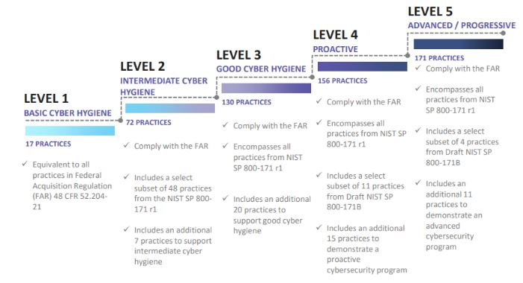
First SP 800-171, then the CMMC Model
NIST SP 800-171: 14 “Families,” 110 Controls
Access Control (2/20) | Awareness & Training (2/1) | Audit & Accountability (2/7) | Configuration Management (2/7) | Identification & Authentication (2/9)
Incident Response (2/1) | Maintenance (2/4) | Media Protection (3/6) | Personnel Security (2/0) | Physical Protection (2/4)
Risk Assessment (1/2) | Security Assessment (4/0) | Systems & Comm Protection (2/14) | System & Information Integrity (3/4)
Notes:
SP 800-171 allocates 110 security requirements into 14 separate families. Some call for hardware, some for software, some for policies, some for process. That is proving demanding for many defense suppliers, but the demands of CMMC add to the requirements, even for ML3, which is the approximate counterpart to SP 800-171. Demands – financial, technical, and human resource increase for the higher maturity levels of CMMC. Best in class companies, already at or beyond 171 and ML3. But that is likely the small percentage. For others, it could take some time, even years, to get to a high score on 171 and readiness for CMMC L3. It’s appropriate to think about the best approach at the system level, which may take some time to achieve, as well as discrete measures that can be taken sooner. A sound objective, for purposes of compliance, as well as protection fo enterprise value, are measures which are effective and have “high value” to protect critical assets and mitigate (or avoid) worst plausible harms of a system compromise.

Slide 17
Information Protection Has Central Protection
The focus of the cyber DFARS and the CMMC initiative is on the confidentiality of Controlled Unclassified Information (CUI)
SP 800-171 and CMMC ML3 focus on “cyber-IT” threats to network security.
The outcome sought by DoD is to avoid compromise as occurs when adversaries gain unauthorized access to CUI of defense suppliers.
Measures adopted to comply with the DFARS also protect enterprise value against loss of proprietary information, IP, financial information, etc.
Strong data protection measures also protect the integrity and availability of information and can minimize damage if breach occurs.
These are urgent considerations, even if outside DoD’s immediate focus.
Notes:
There are many facets to SP 800-171 and CMMC requirements, but DoD’s central purpose, for both, is to protect the confidentiality of Controlled Unclassified Information. DoD seeks to stop the exfiltration – theft – of CUI. Commercial enterprises of all kinds share the objective of protecting their valuable, sensitive information against threats to steal that information, deny its availability (ransomware) or corrupt its integrity. While it is proving difficult to make networks so secure that they cannot be breached, it is possible to make it very difficult, perhaps even impossible, for adversaries (of any kind) to realize value from intercepted communications or stolen data. The value of data can be protected with strong encryption in place, at rest and in transit, from end-to-end in communications, coupled with tight limits on the ability of any intermediary to gain unauthorized access. While not a complete solution – strong protection of information assets and workforce communications is attractive as a cost-effective means that is complementary to other system measures such as upgrading premises systems or move to secure cloud.

Slide 18
Paths to Compliance and Security
The interim DFARS is effective. Companies are focusing on compliance.
The defense industrial base is complex and diverse. The “path” to compliance will be difficult for many, time-consuming and expensive.
Prime contractors have multiple reasons to assist their suppliers.
Choices must reflect economics and realistic resource availability.
As companies work towards complete solutions – which may be on-premise or cloud-based – they should consider interim measures.
As part of their long-term compliance plan and program, companies should consider measures they can accomplish promptly and at relatively low cost. Strong encryption improves protection of communications and sensitive files. If a breach occur, compromised messages and files have been rendered useless to the attacker. This is a positive result for the Government, primes and the affected enterprise itself. Early, enhanced information protection is complementary to system-level protections.
Notes:
DoD has made improved network protection and information security a matter of compliance, meaning that companies may not be eligible for DoD work without satisfying the DFARS cyber requirements and then obtaining CMMC certification. There is enormous diversity within the defense industrial base – not to mention larger and different commercial To achieve the maximum SPRS score under SP 800-171 will take time for many companies. More time will be needed for many companies to reach the more demanding and additional requirements of CMMC ML3 – and to be 100% compliant, as is to be required. The “ground truth” is that companies will take different courses to get to compliance, and to sustain security. This doesn’t deny the importance of enterprise level system improvements. But it does spotlight the benefit of near-term, low-cost, easy to deploy measures that provide “hard” protection to communications and data assets. Such measures, as PreVeil promotes itself as offering, broadly benefit all participants at every level of the DoD supply chain (DoD, primes, subs) as well as enterprises more generally who employ such measures as prudent business conduct.

Slide 19
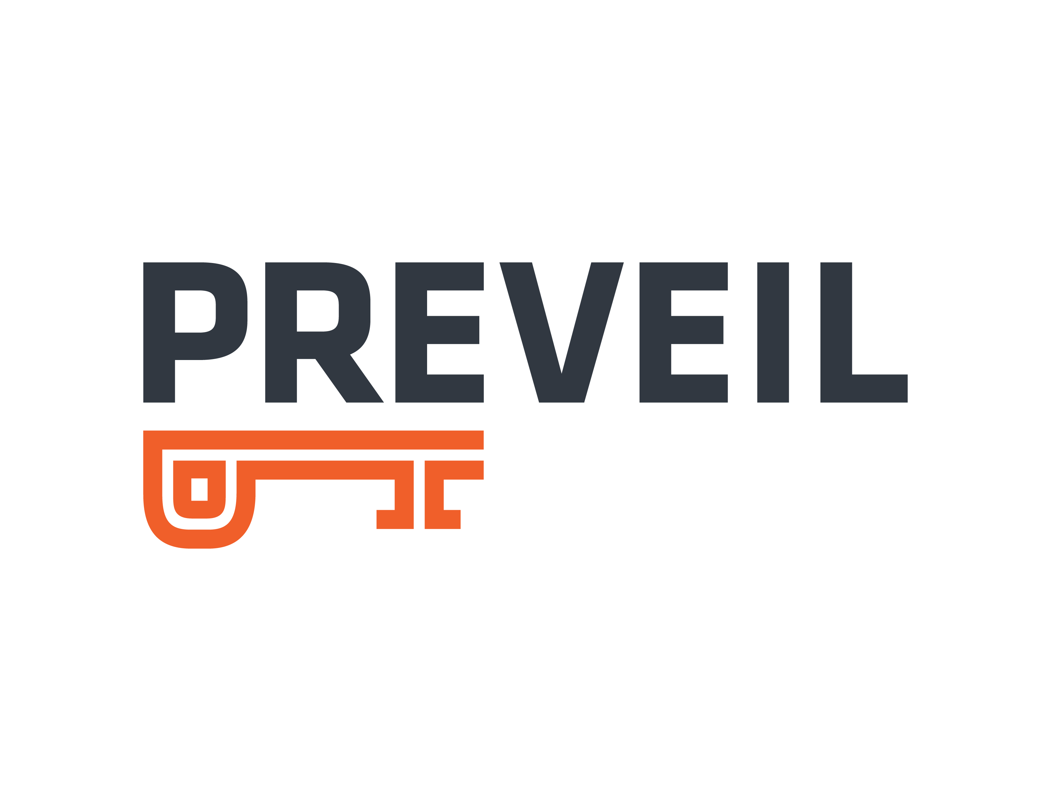
Securing The DIB Supply Chain Cloud-based Encrypted File Sharing & Email

Slide 20
PreVeil Benefits For Supply Chain
Protect Intellectual Property
Design specifications
Engineering drawings
Source code & algorithms
Protect Financial Information
Banking information & credentials
Facilitate Compliance
CMMC — Cybersecurity Maturity Metric Certification
ITAR — International Traffic in Arms Regulations

Slide 21
Supply Base Security
“Cybersecurity risks threaten the defense industry and the national security of the U.S. government… Attacking a sub-tier supplier is far more appealing than a prime” — Ellen Lord, Fmr Assistant Secretary of Def.
Objectives
Innovation
Specialization
Speed
Cost
Challenges
Weak controls
“Forgotten” Files
Multi-level distribution
“Long Tail” supply base
sub
Prime
sub
sub

Slide 22
PreVeil Security
PreVeil Security
22

Slide 23
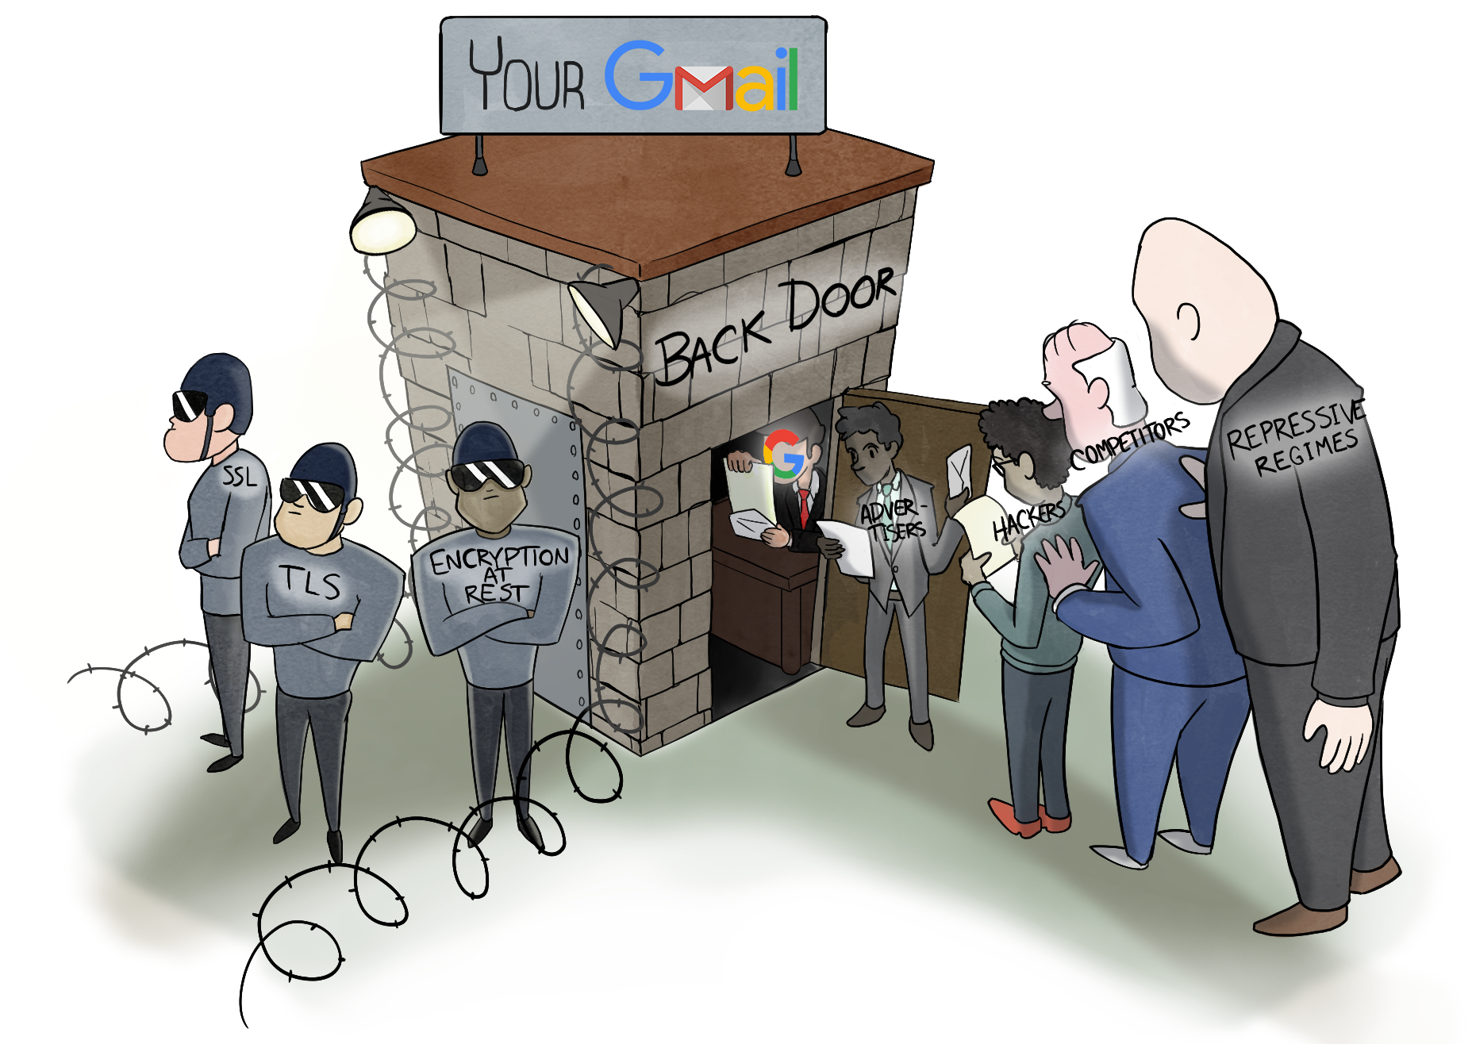

Slide 24

Traditional File & Mail Servers
Plain Text
Plain Text
Company B
Server
Internet
Company A
Server
Plain Text
Company C
Server
Plain Text
Company D
Server

Slide 25

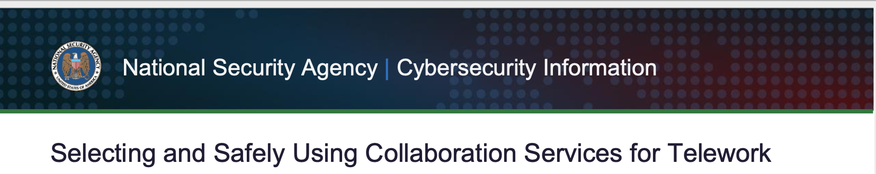
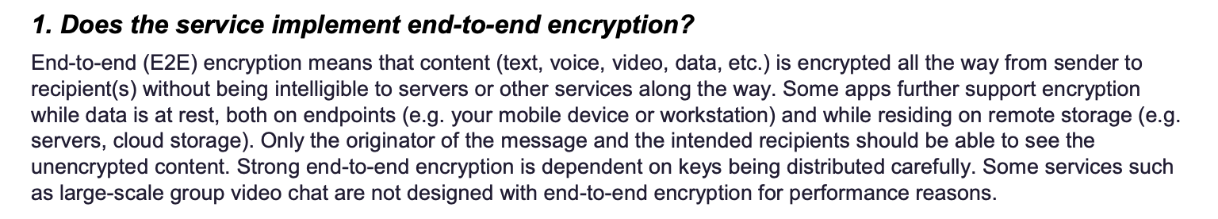
End-to-end Encryption
Encrypt
PreVeil Server
Company B
Decrypt
Company C
Company A
Company D

Slide 26

Passwords vs. Keys
Traditional System
PreVeil
Server
Server
Password
Key stored on device required for decryption
Password
Attacker obtaining password can log in remotely
Attacker

Slide 27






Administrative Vulnerabilities
Traditional System
Any admin can perform sensitive operations:
Reset passwords
Export data
Delete users
And so can an attacker
PreVeil
Admins can perform sensitive functions only with after being authorized by an “approval group.”
Example — Exporting Data:
Encrypted
Decrypted
Server
Server
Files & Emails
Admin
Admin
Exported Data
Attacker
Exported Data
Approvers

Slide 28




External Access Control
Traditional System: Open to the Internet
PreVeil’s Trusted Communities
X
X
Internet
Suppliers
Organization
Organization
Customers
Suppliers
Customers
Attackers

Slide 29

Powerful Sharing Permissions

Slide 30
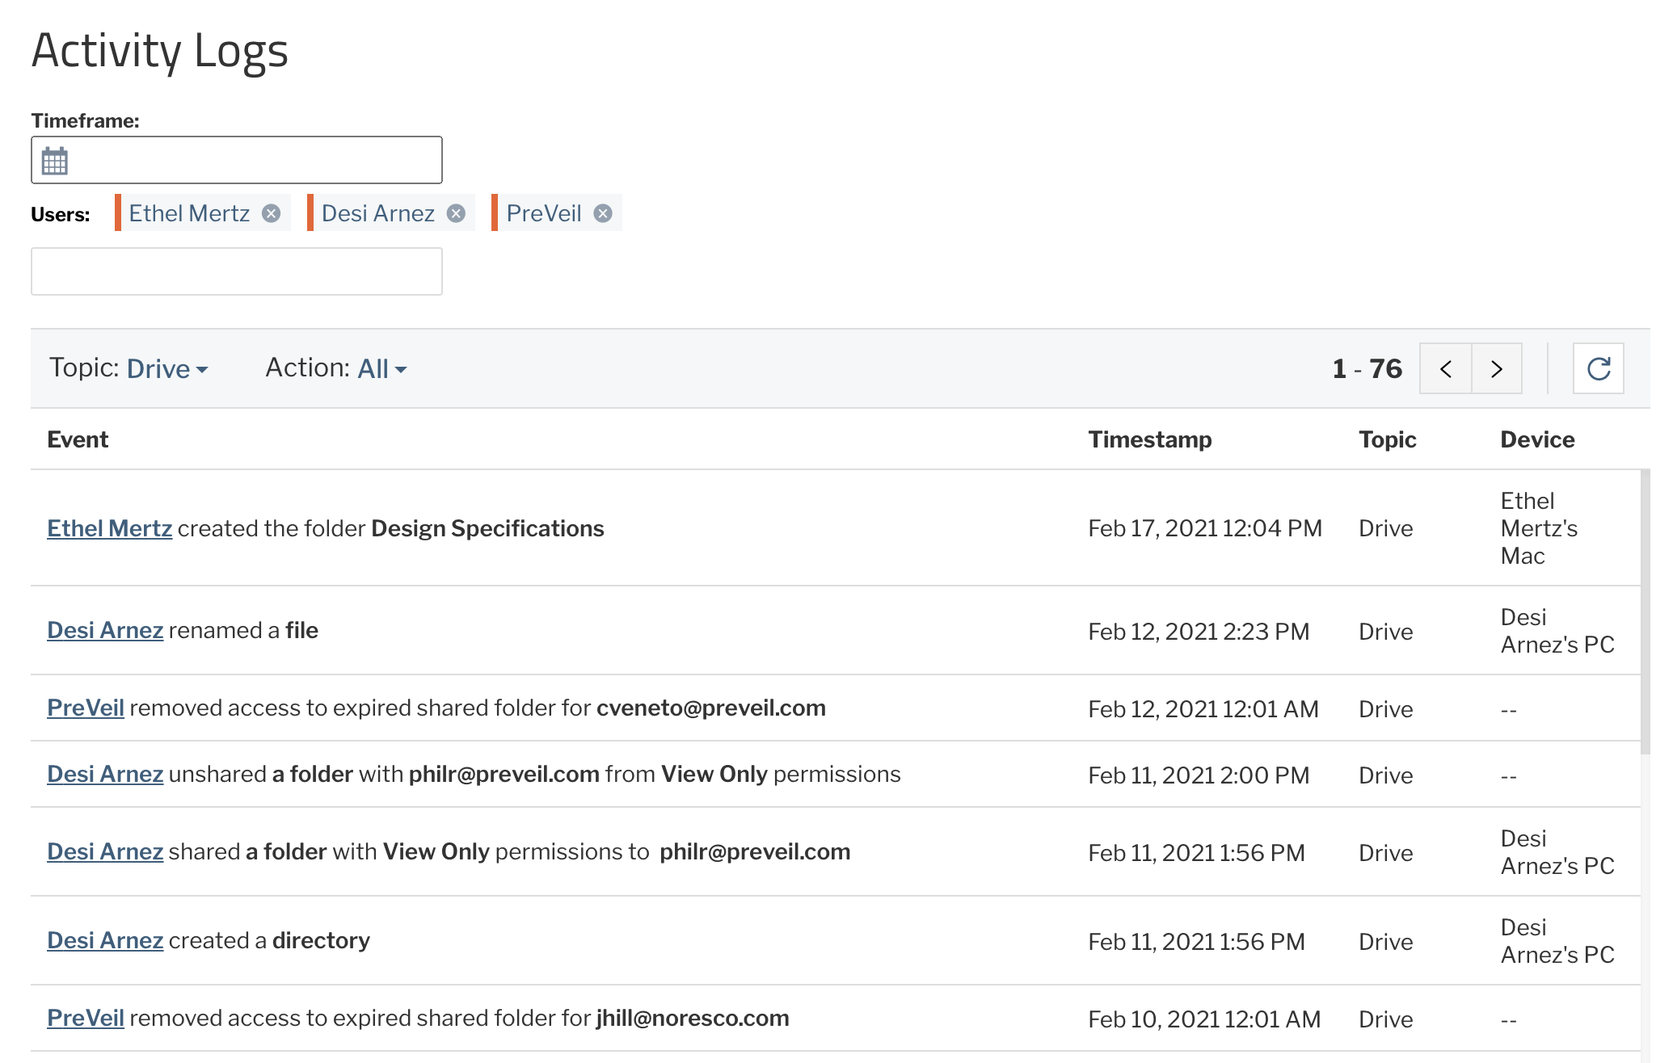
Audit & Monitoring Logs

Slide 31
Demonstration

Slide 32
CMMC Domains: Policies, Processes, Systems
Access Control
Asset Management
Audit & Accountability
Awareness & Training
Configuration Management
Mostly Systems
Identification & Authentication
Incident Response
Maintenance
Media Protection
Personnel Security
Both Systems & Processes
Physical Protection
Recovery
Risk Management
Security Assessment
Situational Awareness
Mostly Policies & Processes
System & Communications Protection
System & information Integrity

Slide 33
PreVeil Can Be Used with ITAR Data
…paragraph (a)(5)… it is not a controlled event to send, take, or store unclassified technical data when it is effectively encrypted using end-to-end encryption.
Therefore, a controlled event does not occur when technical data is encrypted prior to leaving the sender's facilities and remains encrypted until decrypted by the intended authorized recipient or retrieved by the sender, as in the case of remote storage.

Slide 34
Key Takeaways
All companies across the Defense Industrial Base need to secure their supply chains
PreVeil helps:
Protect valuable intellectual property
Protect financial assets
Facilitate compliance
It’s easy to use, easy to deploy, and cost-effective

Slide 35
Q&A

