Slide 1
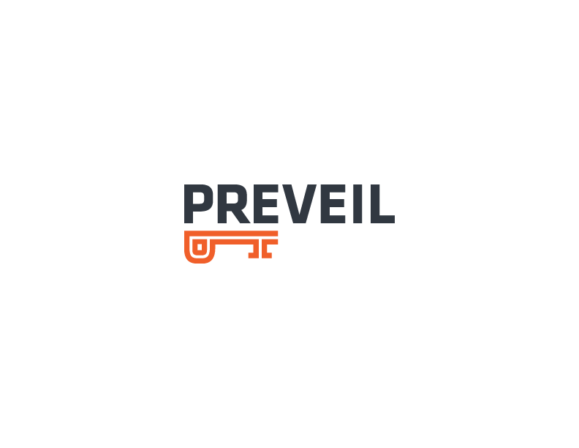
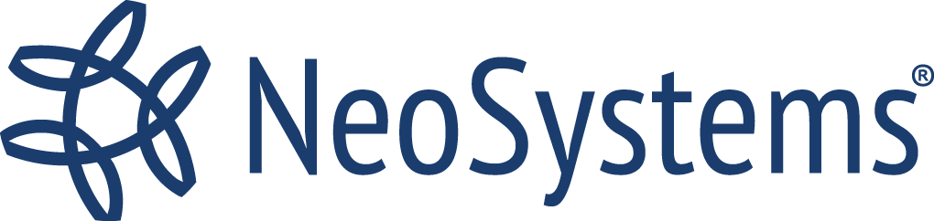
Removing the Barriers to Affordable
DFARS + CMMC Compliance
April 26th | 1 PM ET

Slide 2
Why is NIST 800-171
Compliance a Challenge?
The requirements are exacting
The assessment process is rigorous
It can be hard
It can be expensive
It can be risky and time consuming
IT DOESN’T NEED TO BE

Slide 3
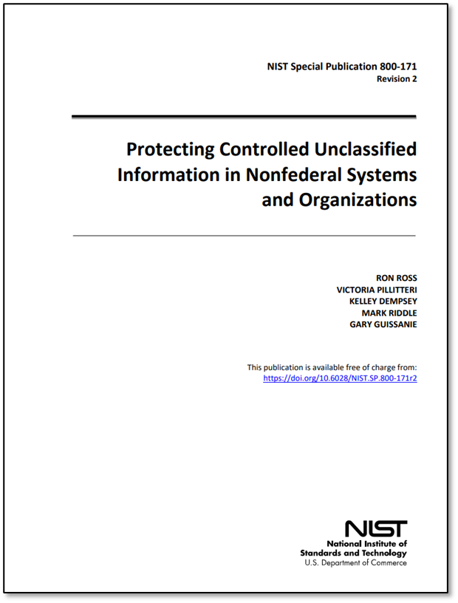
Why is NIST 800-171 a Challenge?
Understanding the requirements
Satisfying the requirements
  Technology
  Policy and Procedure
  Environment
  People
Operating per policy and procedure
Having the required talent
  Skill sets
  Capacity
Being ready for an assessment
Top OTS Requirements
3.13.11 FIPS-validated cryptography (SC)
3.5.3. Multi-factor Authentication (IA)
3.14.1 Identify, report, correct system flaws (SI)
3.11.1 Periodically assess risk (RA)
3.11.2 Scan for vulnerabilities (RA)
3.3.3 Review and update logged events (AU)
3.3.4 Audit logging process failure alerts (AU)
3.3.5 Audit, record, review, analysis & reporting process (AU)
3.6.3 Test Incident response capability (IR)
3.4.1 Establish/maintain baseline configuration (CM)
Demonstrating FedRAMP Moderate Equivalency

Slide 4
Understanding the Cost of Compliance
One-Time Costs (Achieving Compliance)
+ Recurring Costs (Maintaining Compliance)
Total Cost of Compliance
Recurring Costs > One-Time Costs
An alternative to D-I-Y to minimize cost and risk, accelerate compliance
  Leverage Cloud Services
  Leverage Managed Services

Slide 5
Simplifying Compliance: Key Questions
What are My key compliance objectives for DFARS, CMMC
What are cost Drivers for compliance
What are my organization’s capabilities
How WILL CLOUD SERVICES Simplify compliance

Slide 6
Compliance Objectives for DFARS, CMMC
Implement CUI Security via 110 NIST 800-171 Controls for DFARS 7012, CMMC
1
Ensure Encryption is FIPS Validated
2
Ensure Cloud Service Supports Incident Reporting per DFARS 7012(c-g)
3
Ensure Cloud Service is FedRAMP Baseline Moderate Equivalent
4

Slide 7

Your Organization’s Capability
Does everyone in the organization handle CUI ?
Level of IT or Compliance resources ?
Is IT infrastructure within company “standard” ?
Prefer a complete Turnkey solution ?

Slide 8
Cost Drivers of Compliance
Full organization vs Enclave in scope for audit
Rip and Replace existing IT infrastructure with a “Compliant” Platform
Audit Cost
Compliance Documentation

Slide 9
How we Lower Cost & Complexity
“Compliance as a Service”
No Rip & Replace >
Overlay with PreVeil, Address 102 NIST Controls, FIPS, FedRAMP, DFARS, SPRS
Implement “Enclaves” >
Fewer Licenses Needed
Detailed, C3PAO vetted Documentation >
Significant Cost Reduction, Audit Simplified
DIY or via MSP managed Compliance as a Service
”NeoSystems”

Slide 10
Putting It Together
Deploy PreVeil Cloud Service > DFARS, CMMC, SPRS, ITAR, FIPS, FedRAMP
Establish SSP Baseline with PreVeil Documentation for 102 Controls
NeoSystems addresses remaining gaps, manages ongoing compliance

Slide 11
Challenge of Achieving and Maintaining Compliance
Achieving Compliance | Maintaining Compliance | Personnel Requirements
Create a compliant IT environment Implement security tools Develop policies and procedures Create SSP and other documentation Establish continuous monitoring, analysis, and response Train employees Migrate to the new environment | Provide day-to-day IT support Manage and perform patching and system maintenance On-board, off-boarding employees, manage access Perform continuous monitoring and log analysis Operate a change management process | Compliance Experts System Architects IT Technicians IT Support (Desk Desk) Information Security Experts Incident Responders (Human Resources) Capacity and Availability PTO, terminations, high demand Available on demand
Adopt a Known Compliant Solution Rather than D-I-Y

Slide 12

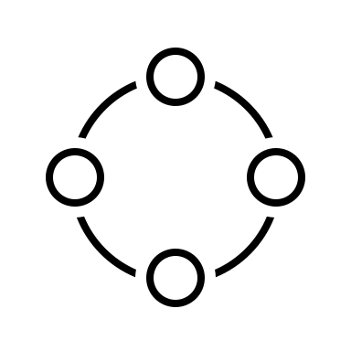


How Does An MSP
Address the Challenges
CMMC Mapped Solutions
Operations and Security Management
Deep and broad pool of shared expert resources
Monitoring & response to new compliance requirements
A Known Compliant Solution Versus D-I-Y

Slide 13


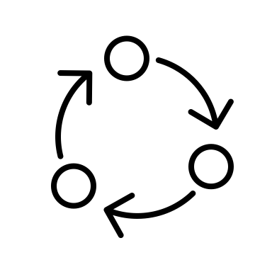

Benefits to Using an MSP Over D-I-Y
Confidence in the solution
Confidence in the people
Confidence in the process
Confidence overall
An accelerated, affordable, predictable, low risk path to CMMC Compliance

Slide 14
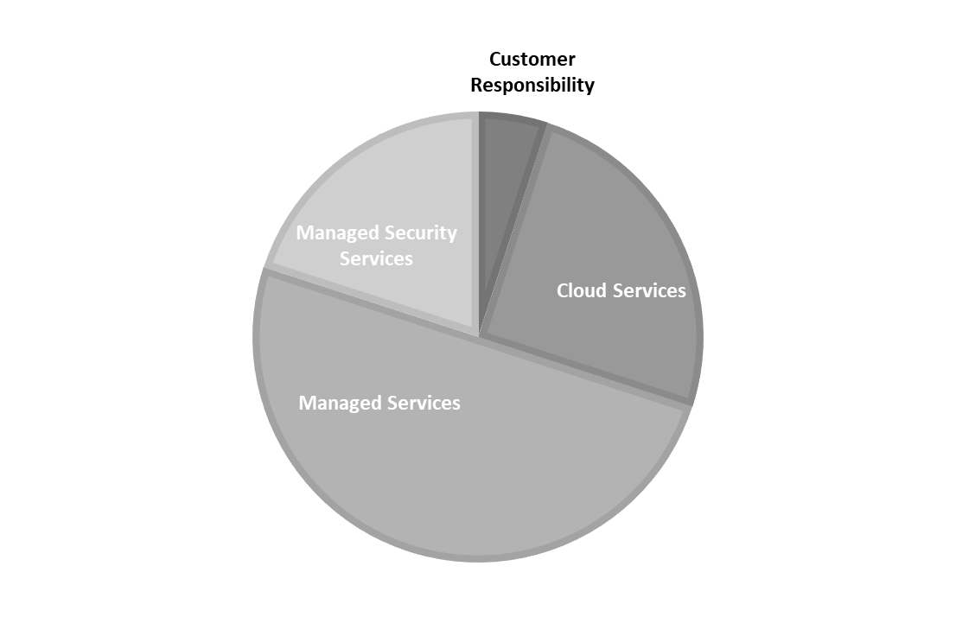
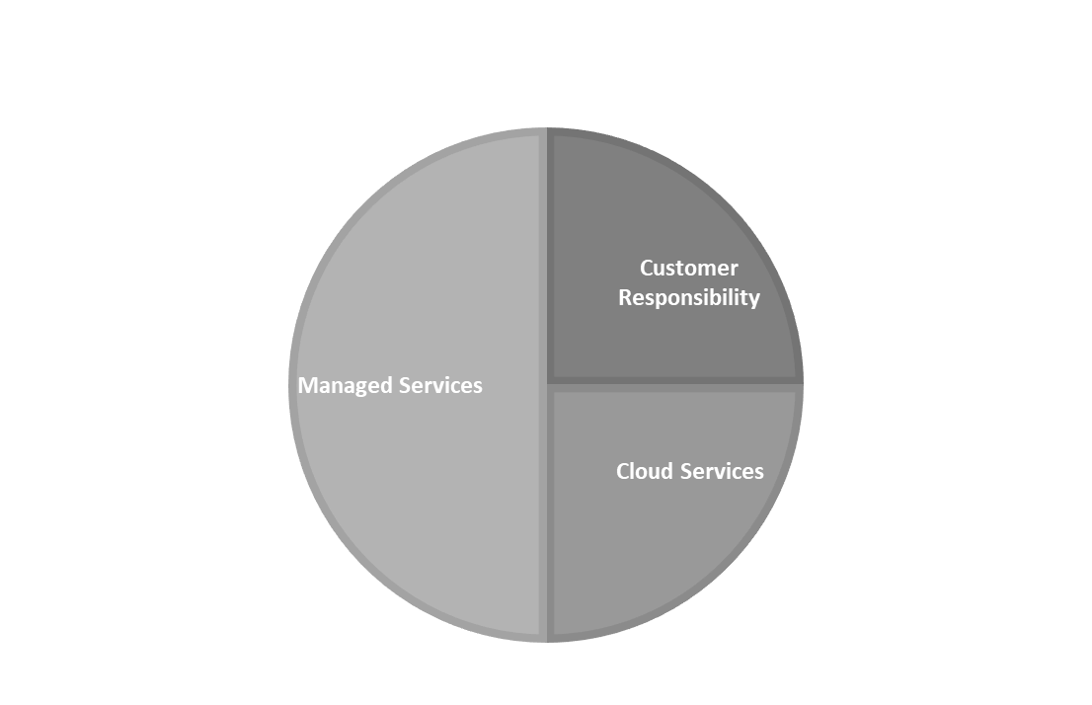
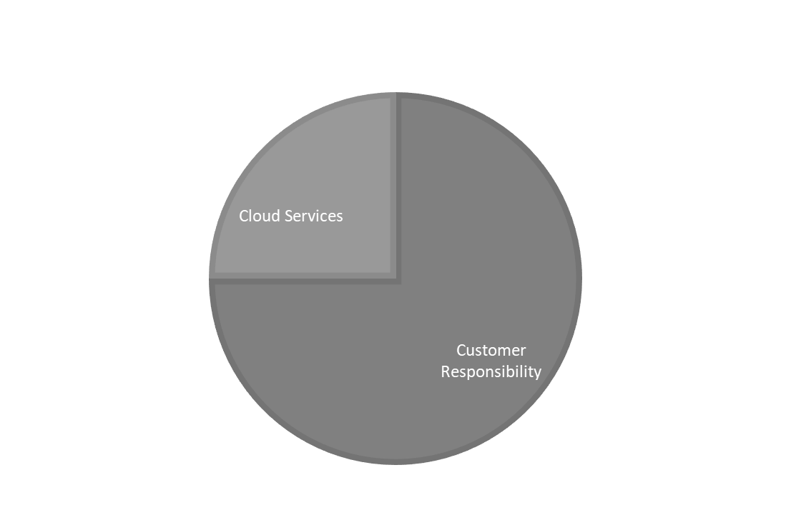
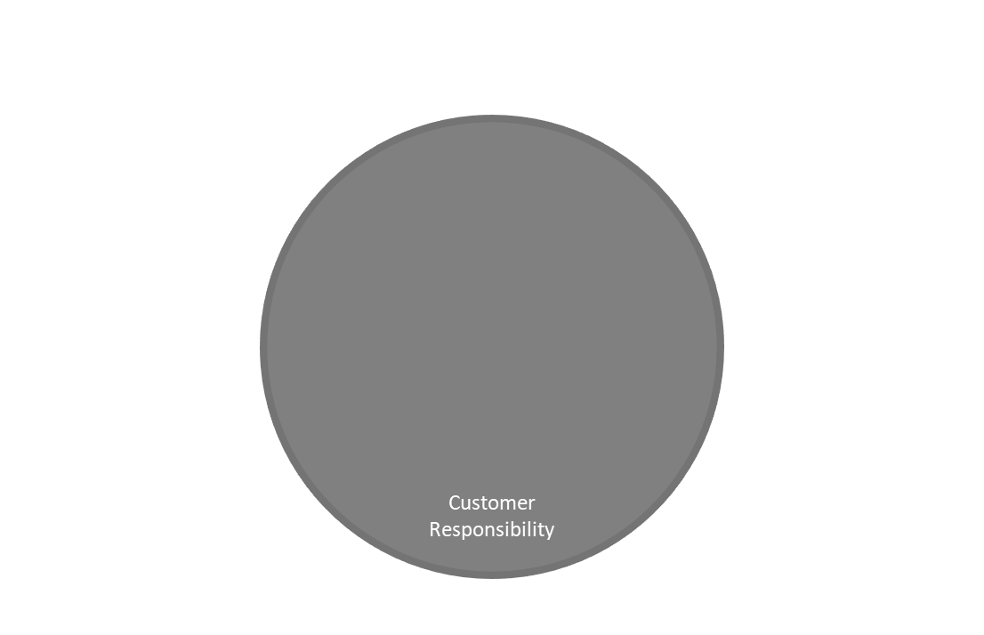
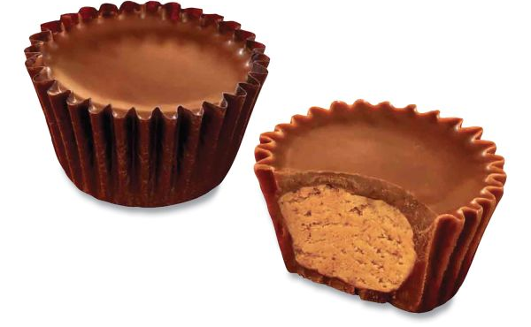
An accelerated, lower cost, lower risk approach
One-Time Costs (Achieving Compliance)
+ Recurring Costs (Maintaining Compliance)
Total Cost of Compliance
The alternative to D-I-Y:
  Leverage Cloud Services
  Leverage Managed Services

Slide 15
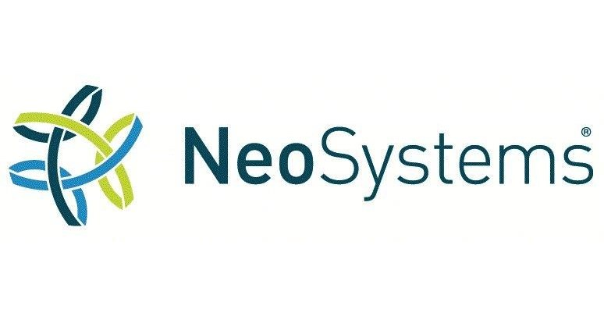
FINIS

Slide 16
FOLLOW UP
www.neosystemscorp.com
growahead@neosystemscorp.com
(571) 234-4940
www.preveil.com
compliance@preveil.com
(617) 579-8305

