Slide 1

What to do When the DoD + Your
Prime Question your Compliance
August 15, 2023

Slide 2
Why did I get this letter?
Primes and Tier 1 contractors under pressure to secure our nation’s data
DFARS 7012, DFARS 7019/7020 requirements
NIST 800-171 compliance is a necessity today
CMMC assessment process looming
The June 2023 DoD Memo

Slide 3
What is the letter asking?
Status of your SSP (System Security Plan)
Timeline for closing POA&Ms (Plan of Action & Milestones)
An SPRS (Supplier Performance Risk System) score at or above a specified level

Slide 4
Two groups of DoD subcontractors
Group 1 -- Those that have already received a letter
Group 2 -- Those that will soon receive a letter

Slide 5
What should you do?
It depends on the status of your cybersecurity program
Three key questions to ask:
Do you have a DFARS compliant platform to support CUI?
Do you have a comprehensive SSP with Policies and SOPs (Standard Operating Procedures)?
Do you have internal compliance expertise or a relationship with a certified NIST/CMMC third-party consultant?

Slide 6
Next steps
Protect the sensitive data as soon as possible
Get a jump start on the compliance documentation challenge
Fill the gaps in your organization’s compliance knowledge base

Slide 7
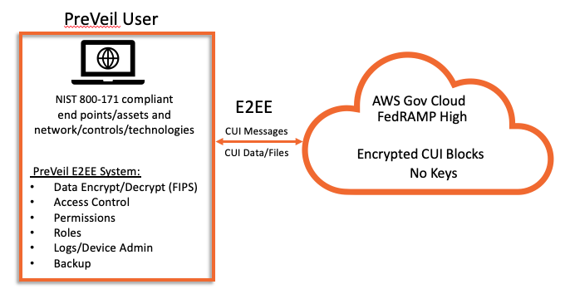
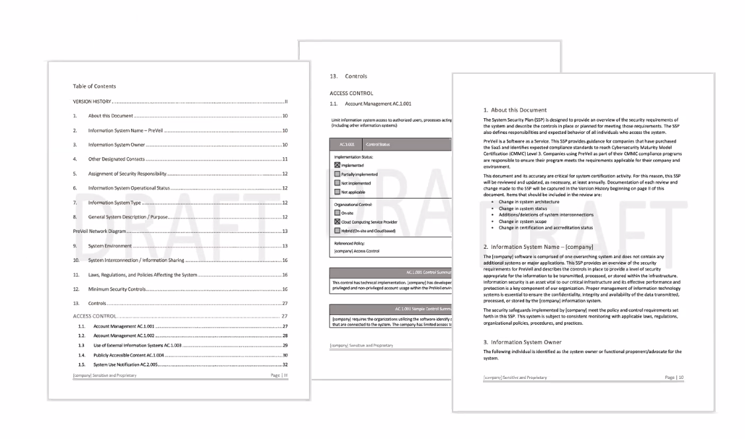
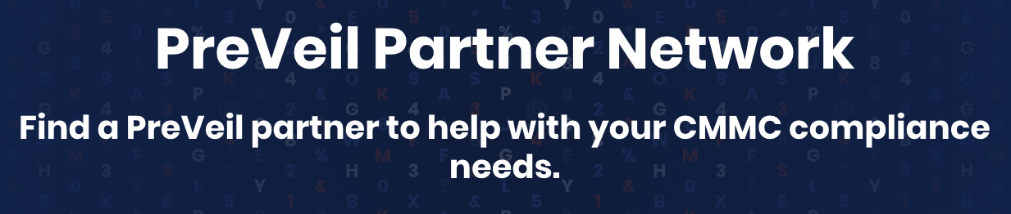
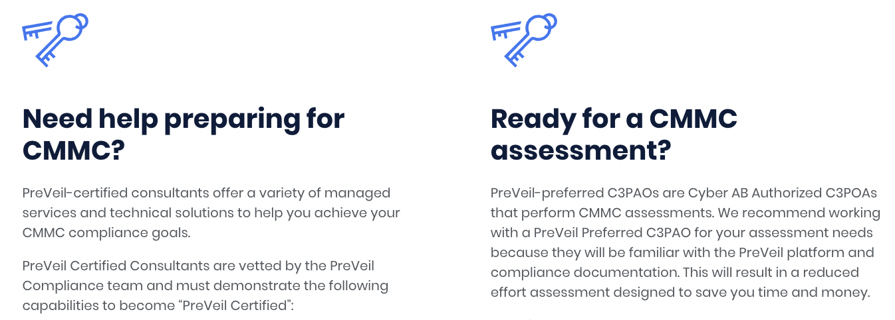
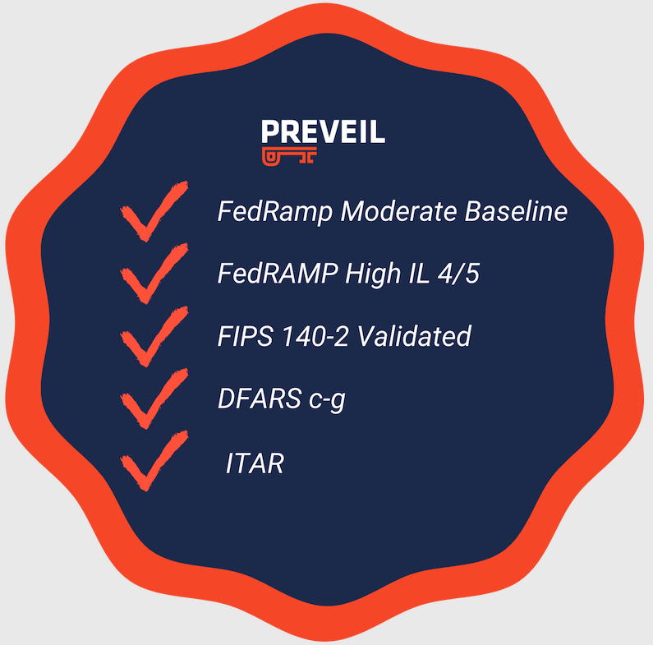
PreVeil’s End to End Compliance Solution
Simple and Secure
DFARS 7012 Compliant Platform
NIST/CMMC Compliance
Documentation & Education
Certified RPO and C3PAO
CMMC Partner Community
The ultimate set of pre-filled compliance documents, education and support customized for PreVeil deployments
Save time and money with certified partners that understand the PreVeil security model and our documentation package
PreVeil is an easy to deploy, compliant system for handling CUI and ITAR

Slide 8
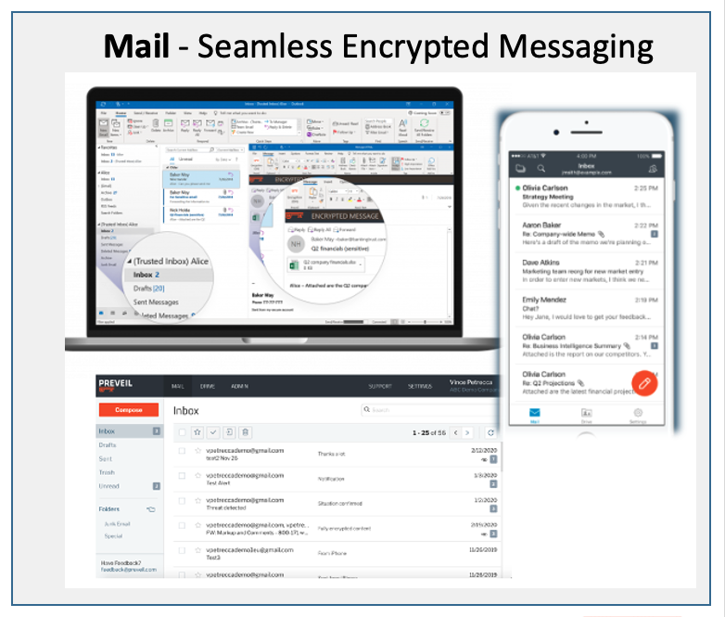
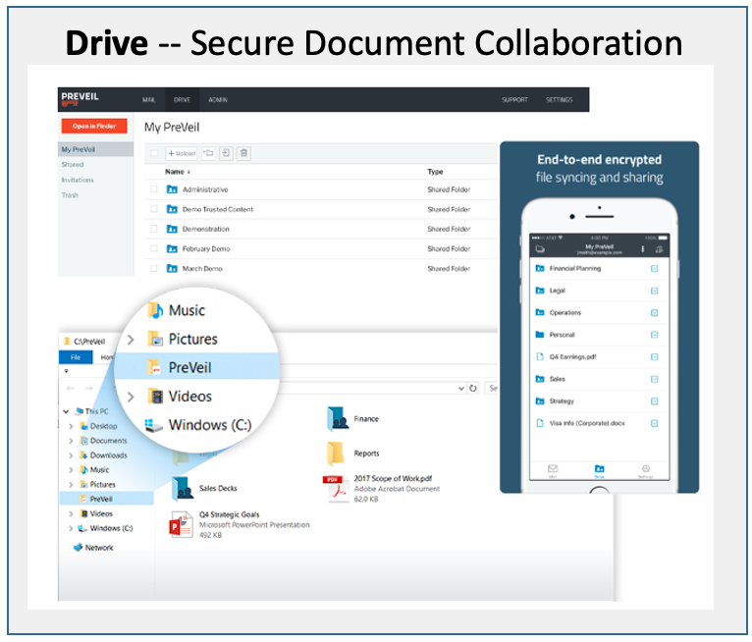





PreVeil Mail & Drive
All data is encrypted and stored in the FedRAMP High Impact AWS GovCloud
Seamlessly integrates with Outlook and File Explorer
Maintain your existing Commercial MS365, Google Workspace or on-premise environment
PreVeil available for

Slide 9
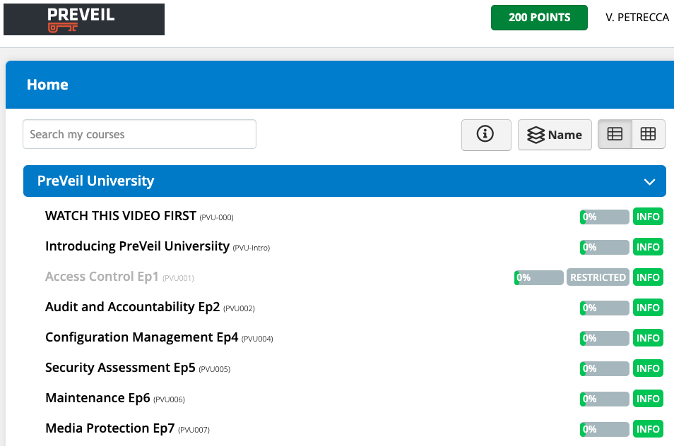
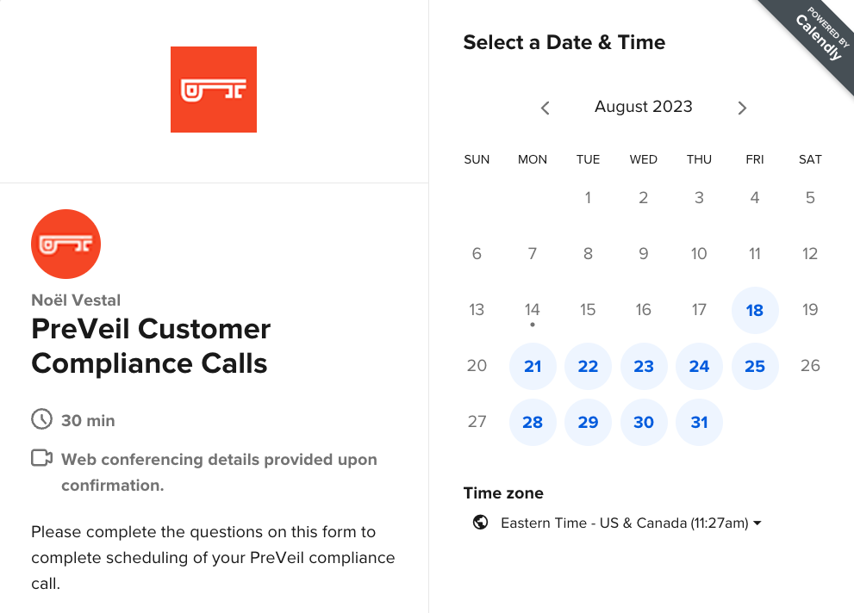
PreVeil Compliance Documentation & Education
Pre-filled SSP, CRM and Policy documents
PreVeil University including SOP and Artifact templates
Support from PreVeil’s own CMMC Certified Professionals
All PreVeil documentation reviewed by Authorized C3PAOs
Save hundreds of hours on NIST/CMMC compliance documentation preparation

Slide 10
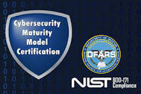

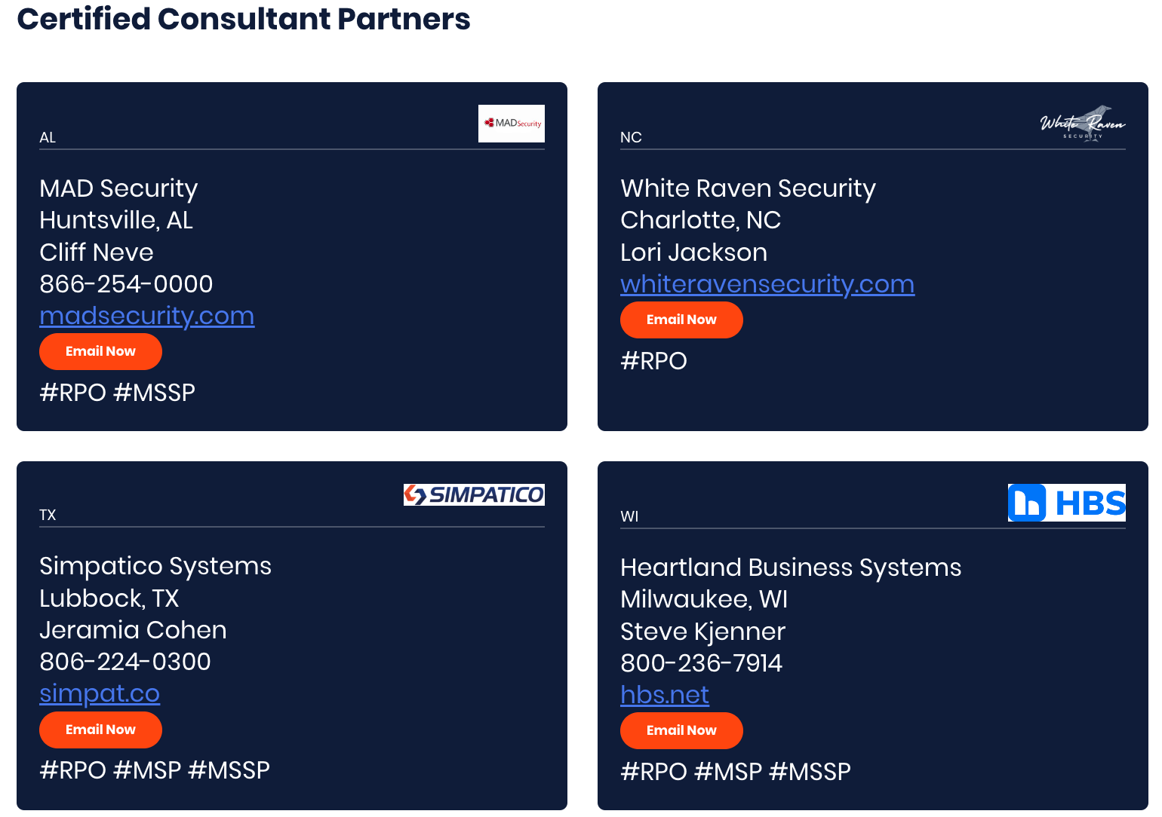
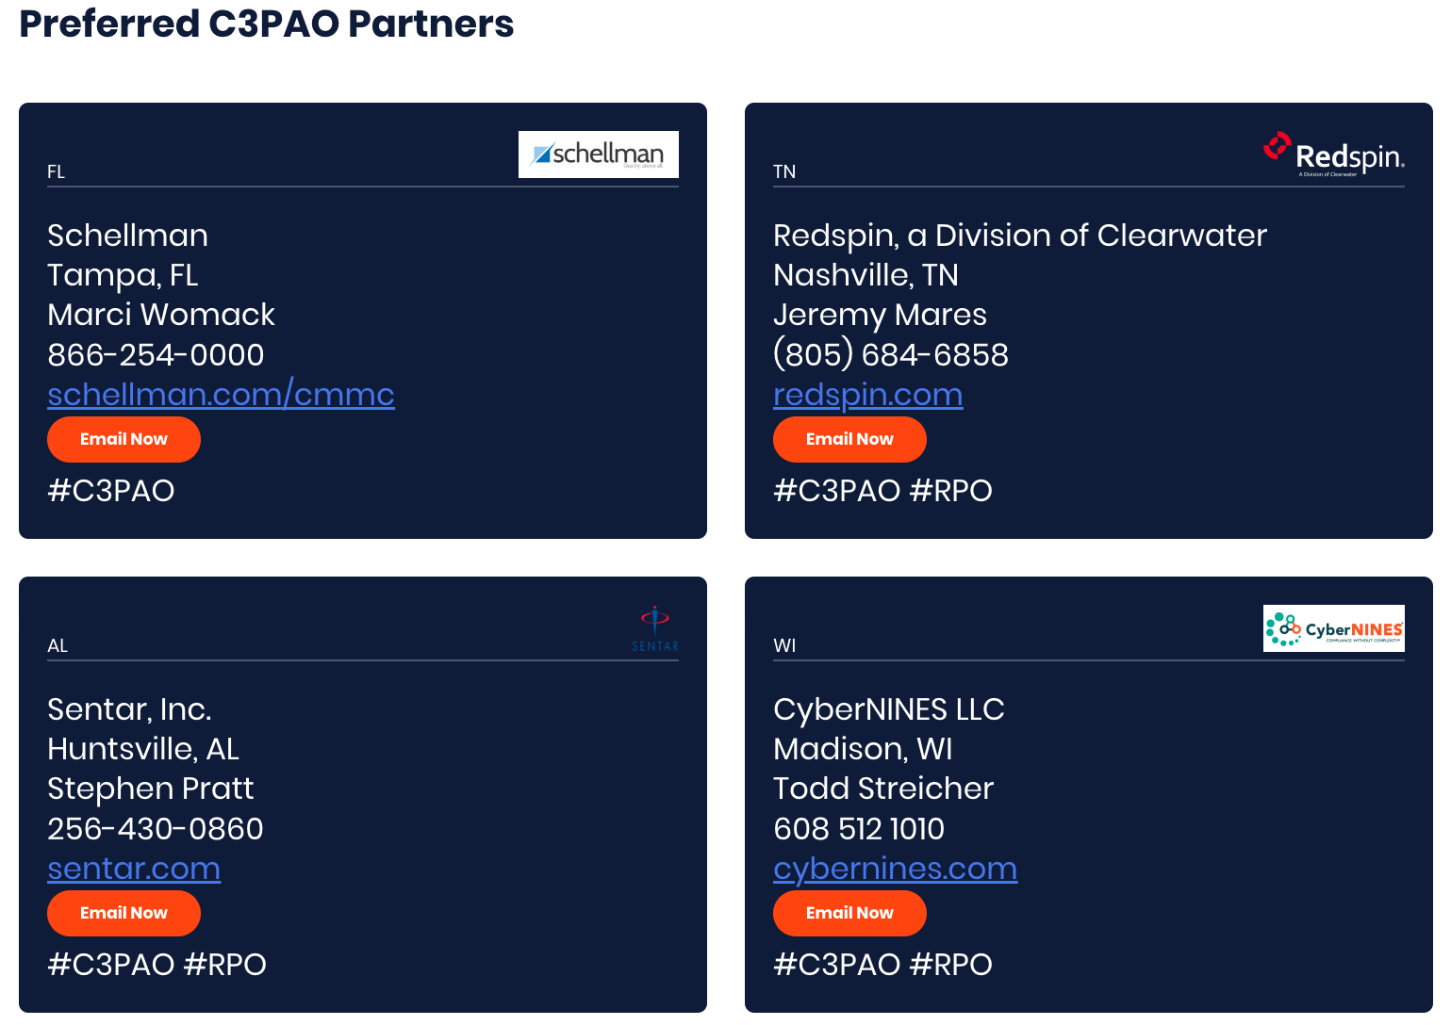

PreVeil’s Certified Partner Community
Supporting your end-to-end DoD compliance journey
Confirm you need CMMC Level 2.0 and the
scope of users that touch
CUI or ITAR
Deploy a DFARS -compliant encryption platform
to
immediately secure data from attack
Generate SSP, Policies, SOPs and other supporting documents for SPRS reporting
Obtain CMMC advice from a PreVeil Certified RP/RPO
Obtain a CMMC assessment from a PreVeil Preferred Authorized C3PAO
Compliance
Certification!

Slide 11
What to do now?
For interested DoD Contractors –
Reach out to your PreVeil account manager
Send an email to sales@preveil.com
Click Contact Sales on our website www.preveil.com
For interested Partners –
Connect with your PreVeil partner manager
Click Become a Partner on our website www.preveil.com

